Slide 1
Salary Dataset Analysis:
An in-depth exploration
By: Reese , Kshitij, Vinh, & Swikar

Slide 2
Background, Objective, and Goals
The dataset in this project is based on data-related jobs in the US. The following characteristic will be the focus of this analysis
Key Performance Indicator: Paid Wage Per Year
The objective for this analysis is to breakdown roles by desirable characteristics in the industry that a worker may consider based on the following:
Employer Name Education Level
College Major Experience
Prevailing Wage Work City/State
Job Title Subgroup.
The goal is to explore these characteristics using data analysis to provide answers for entry-level or existing industry professionals through asking high-level question. This is accomplished by Preparing, Processing, Analyzing, and Visualizing data. This creates a more transparent data story for stakeholders and interested parties.

Slide 3
Question #1: Do specific sub-types of data-related jobs have higher or lower salaries than others?
1a - Which companies have the highest salaries for those subtypes ?
1b - Changes with location of the job ?
1c - Will the answer change if I take the standard of living into account ?

Slide 4
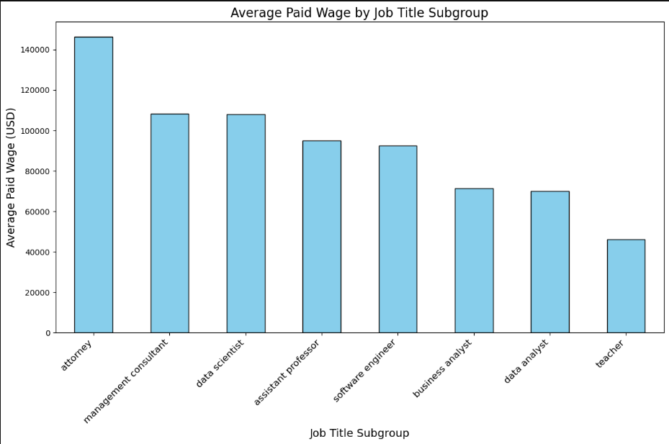
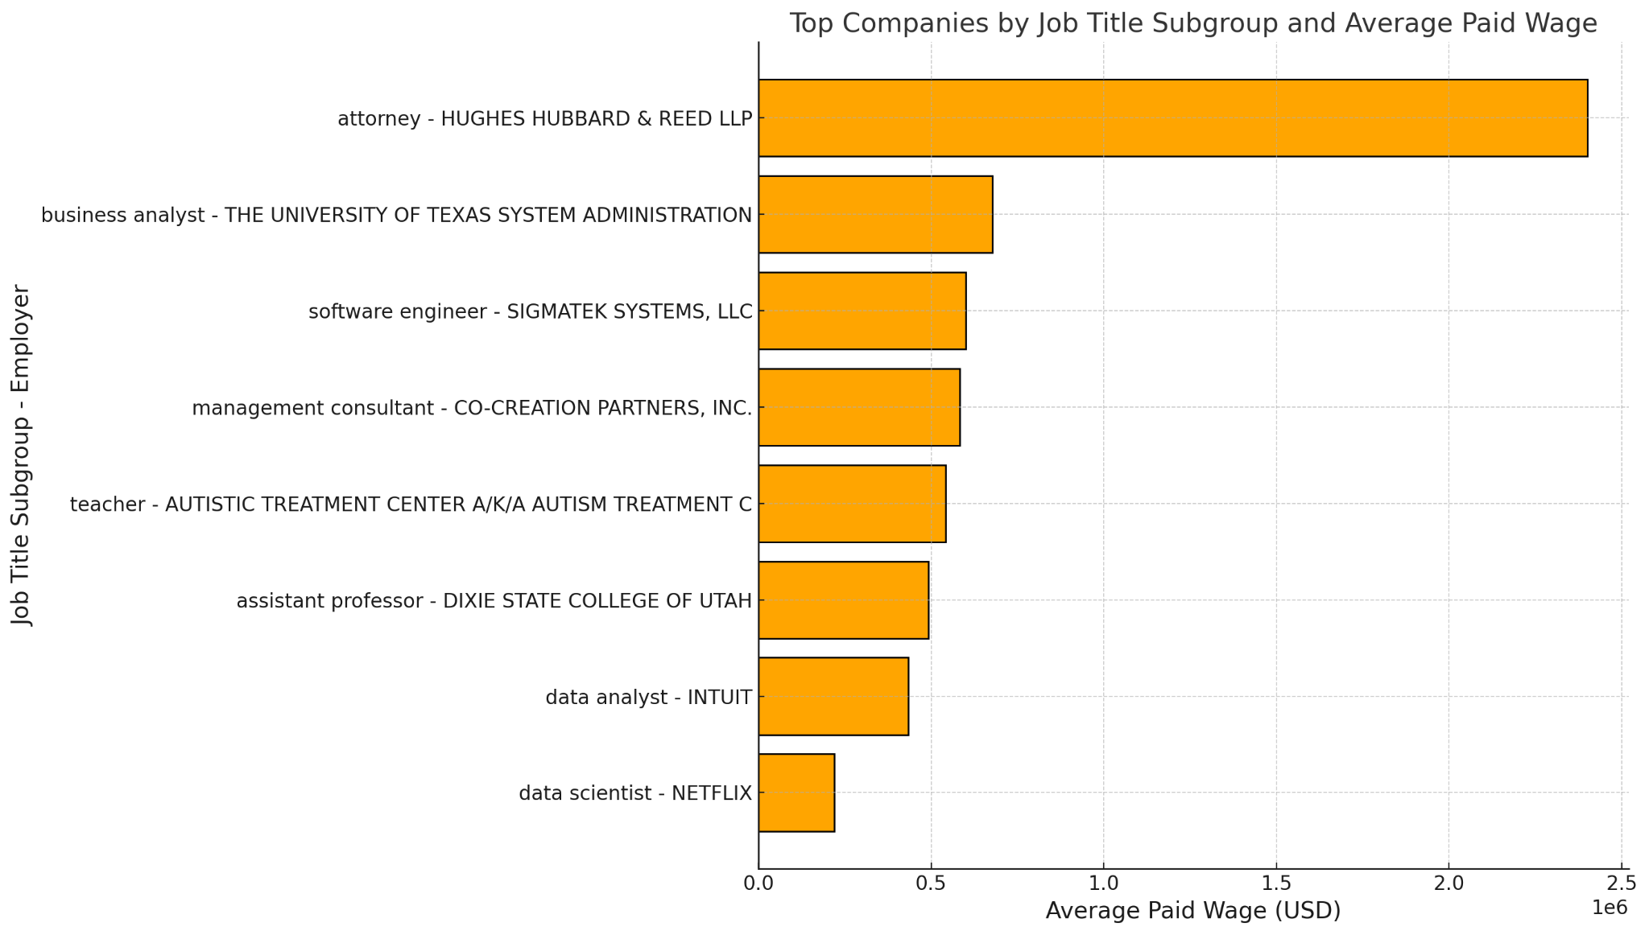
Q1
Q1 Part A

Slide 5
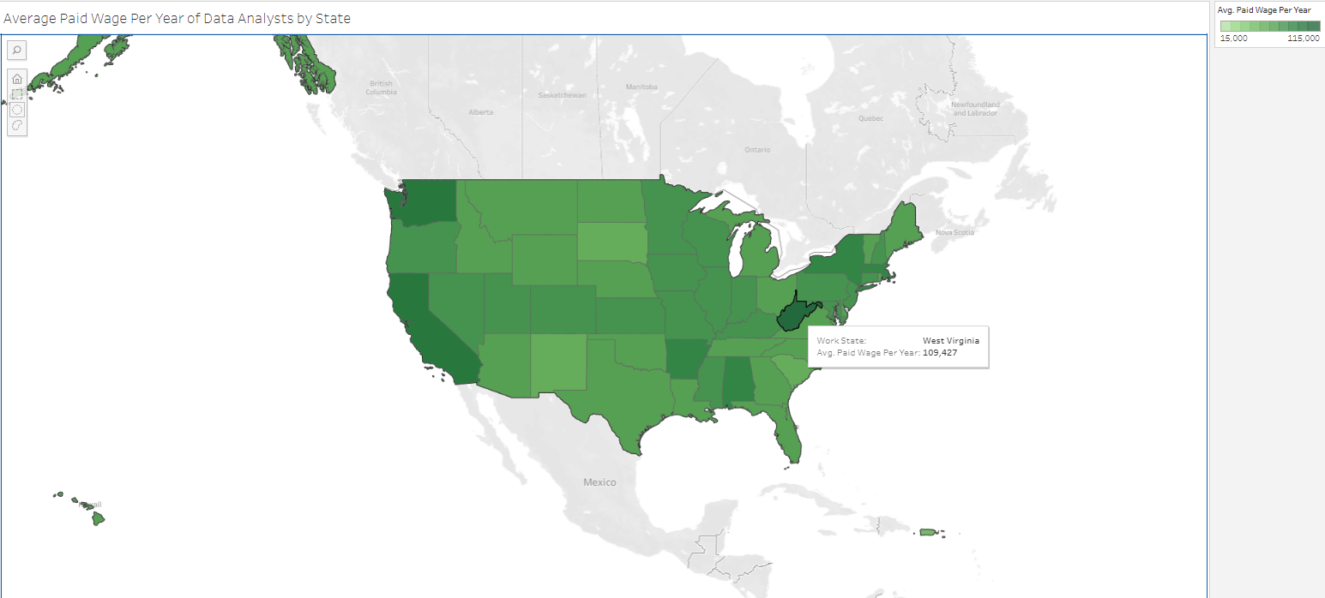
Q1 Part B

Slide 6
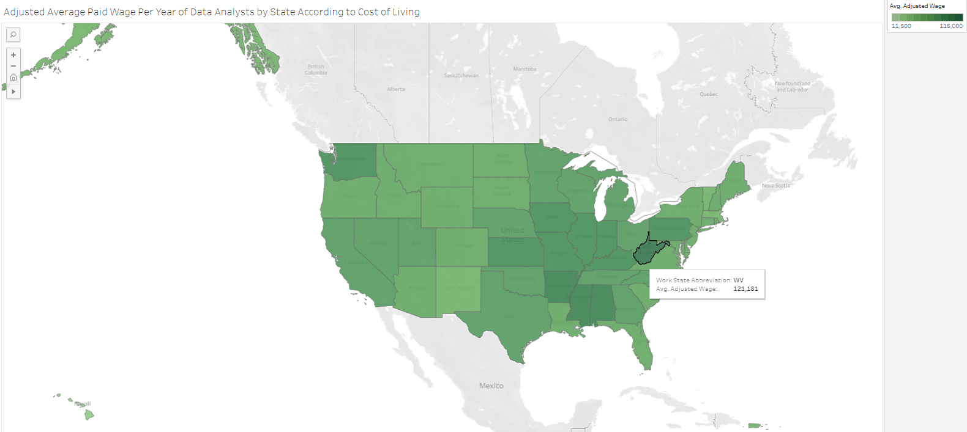
Q1 Part C

Slide 7
Question #2: What states have the highest paying data-related salaries ?
2a - Differences between job subcategories ?
2b - Which companies have the highest salaries of those sub-types ?
2c - Will the answer change if I take the standard of living into account ?

Slide 8
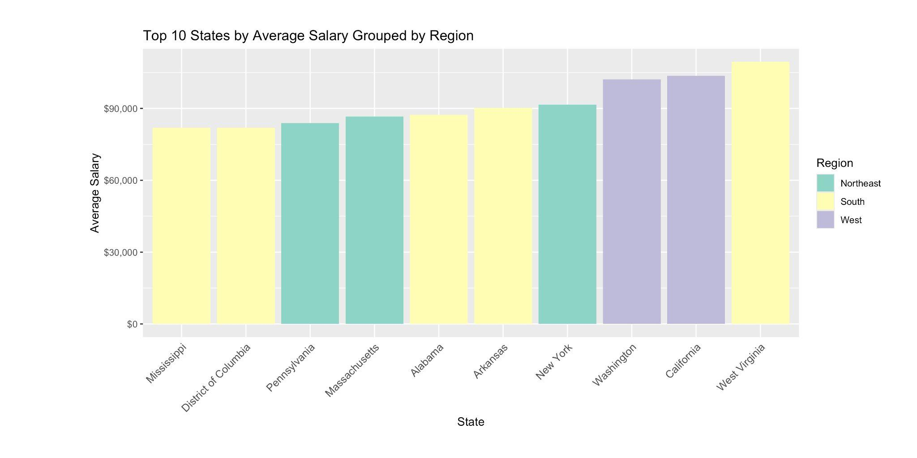
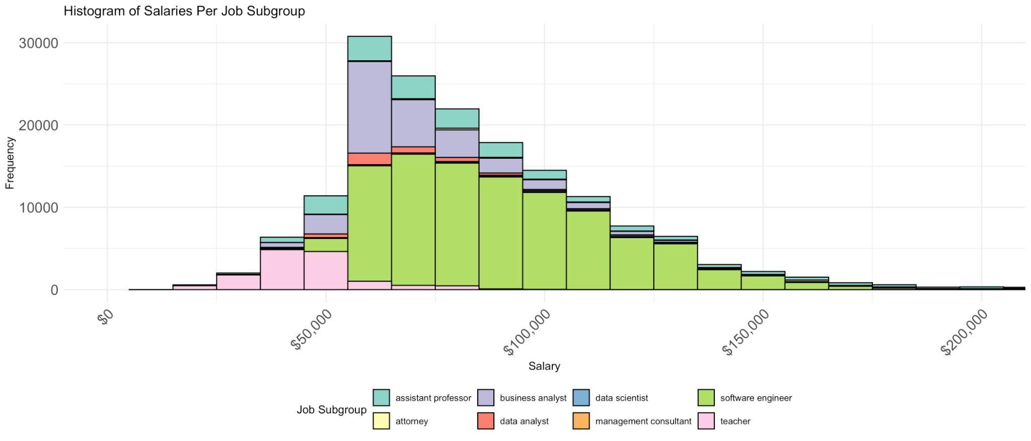
Q2
Q2 Part A

Slide 9
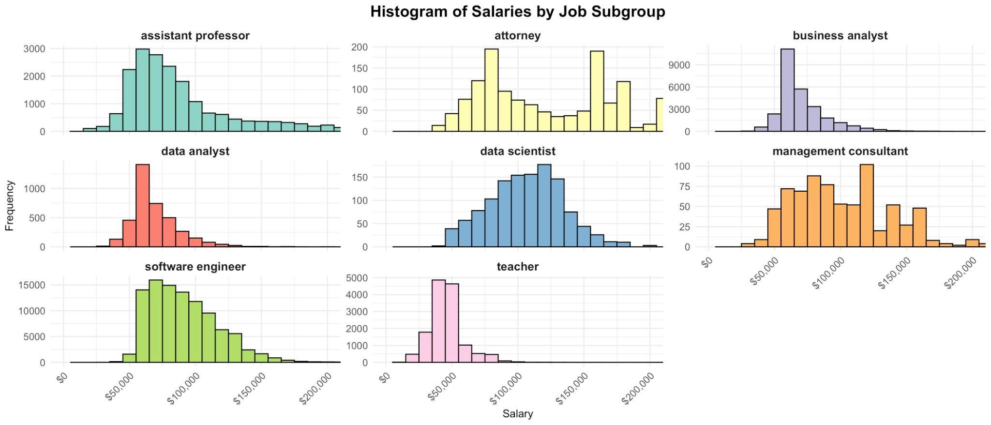
Q2 A, pt II

Slide 10
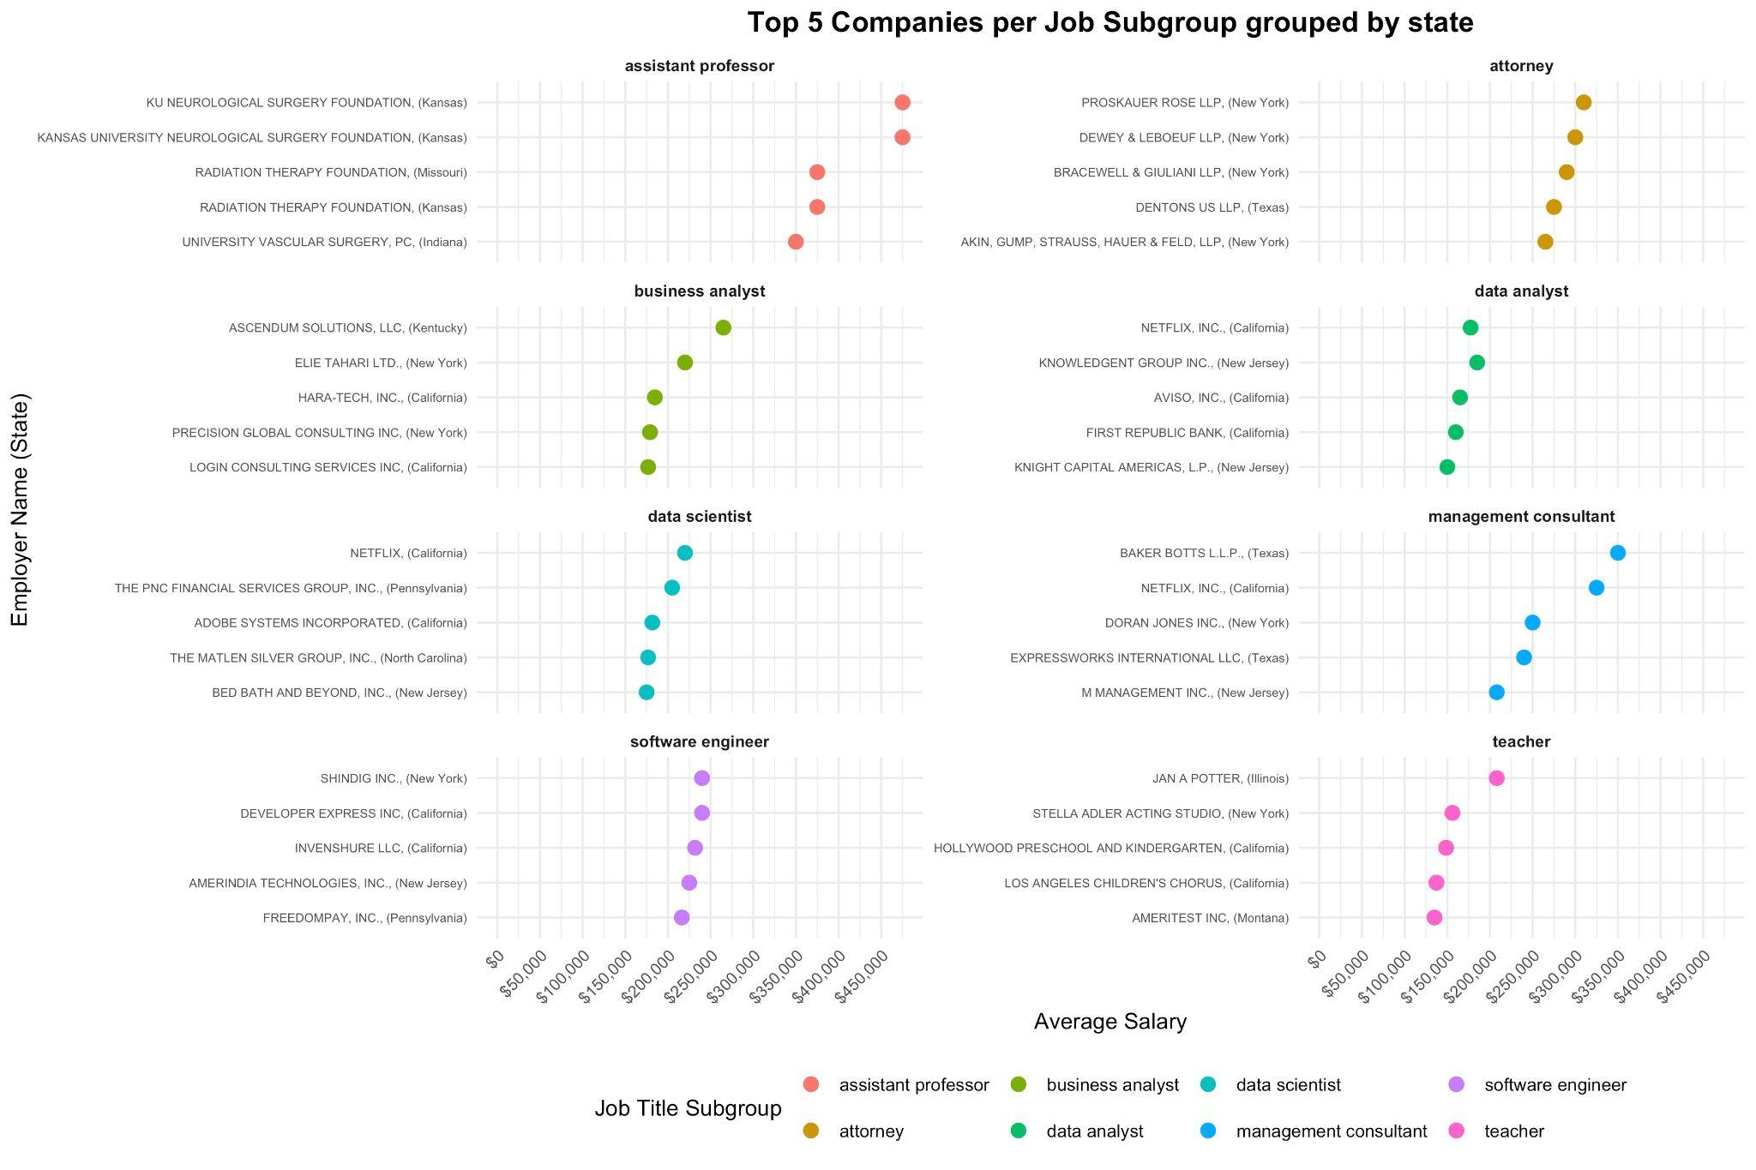
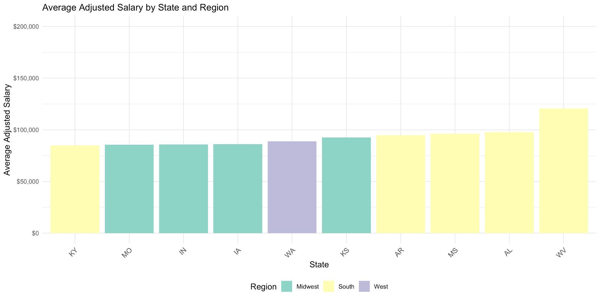
Q2 Part B
Q2 Part C

Slide 11
Question #3: How do offered salaries compare to the prevailing wage ?
3a - Are there job sub-categories that tend to get over- or under- paid ?
3b - Are there companies that tend to over- or under- pay ?
3c - Will the answer change if I take the standard of living into account ?

Slide 12
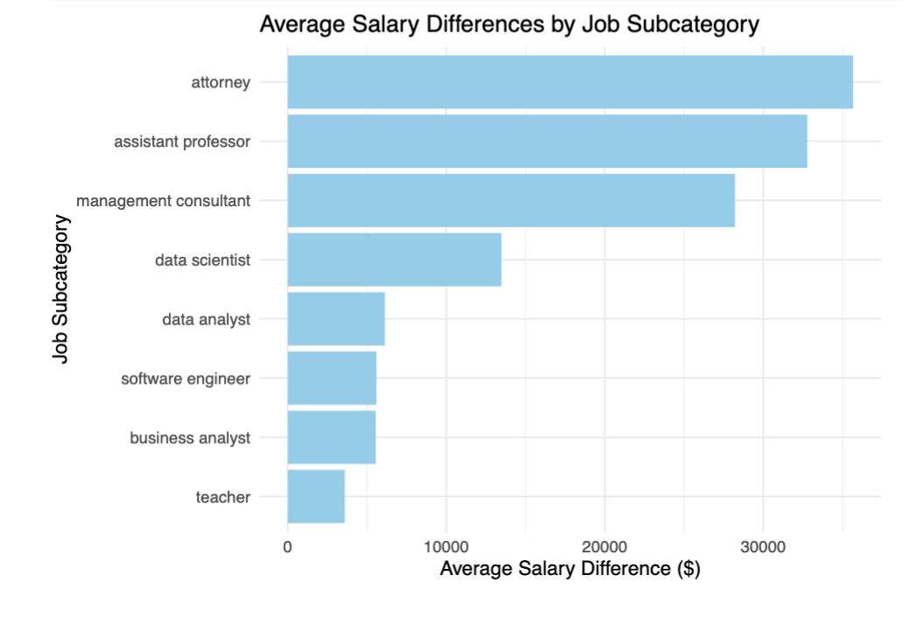
Are there job sub-categories that tend to get over- or under- paid ?

Slide 13
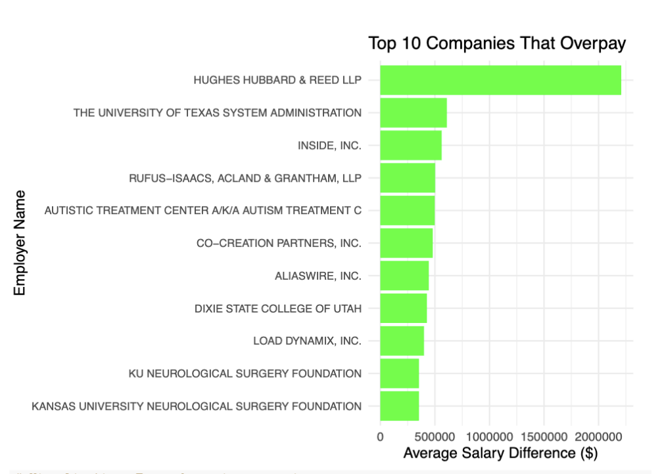
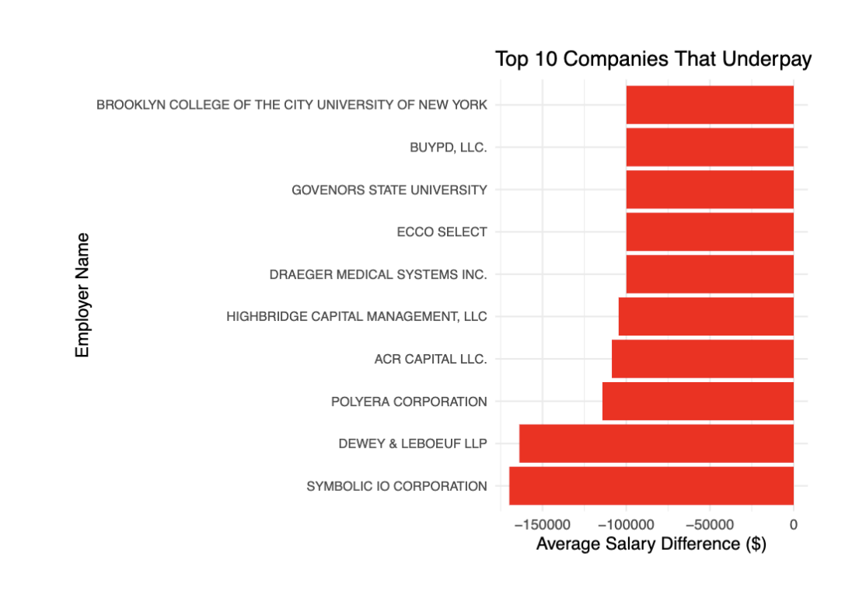
3b - Are there companies that tend to over- or under- pay ?

Slide 14
3c - Will the answer change if I take the standard of living into account ?
The "Average Adjusted Salary Difference by Job Subcategory (Considering COLI)" table is sufficient to evaluate how COLI influences over- or underpayment. Adjusted salary differences already incorporate cost-of-living factors, making this data appropriate.

Slide 15
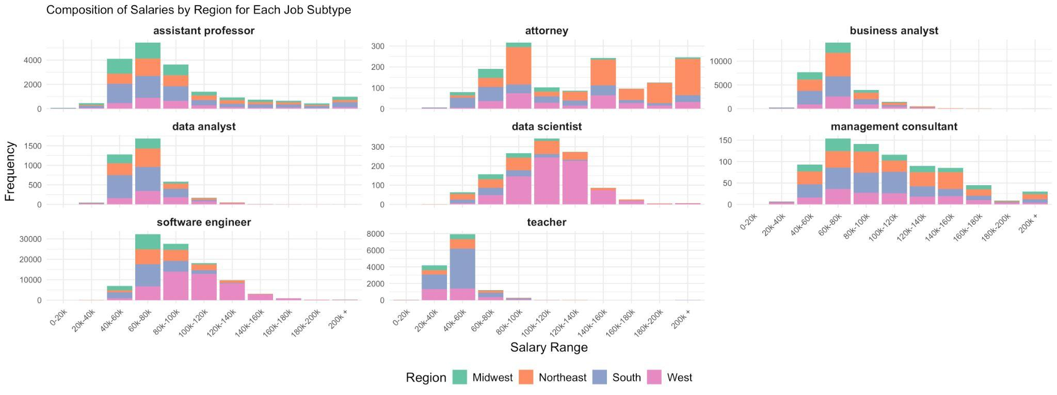
Question #4: How do salaries differ per geographic region ? Are there specific data-related roles found in these regions ?

Slide 16
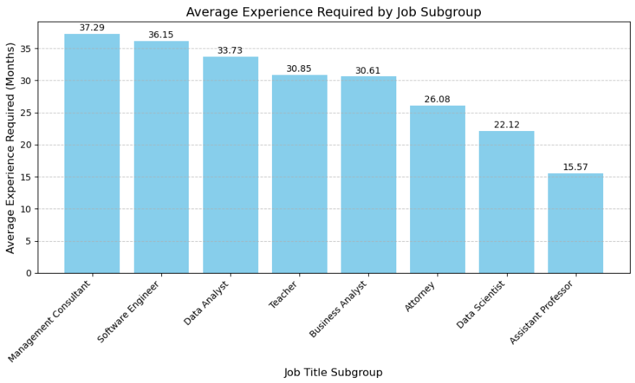
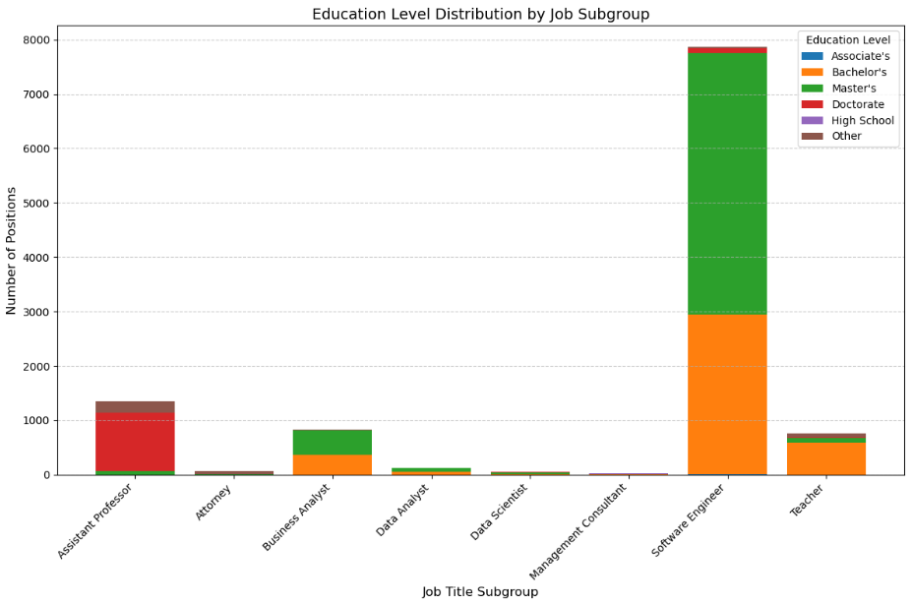
Question #5: What specific sub-types require higher experience and education, is this correlated with salary ?

Slide 17
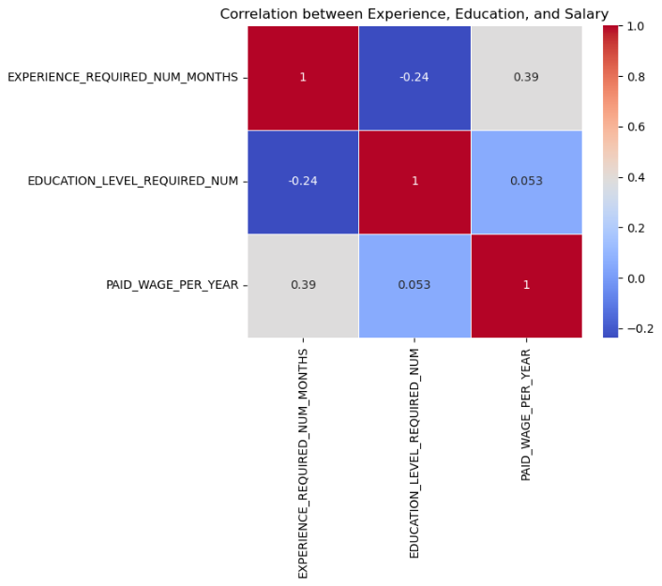

Slide 18
Question #6: What salaries are "normal" when looking at a distribution of salaries. Is there any trends or patterns found within this salary distribution.
6a - What are the mean, median, and mode of the salary distribution, and how do they differ from each other?
6b - Is the distribution of salaries skewed (positively or negatively), and what does the standard deviation tell us about the spread?
6c - Are there identifiable trends or salary bands that are more common for specific groups, such as by industry, experience level, or geographic region?

Slide 19
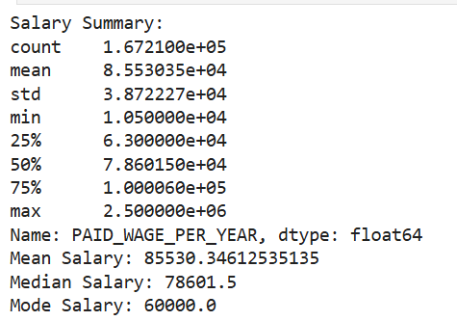
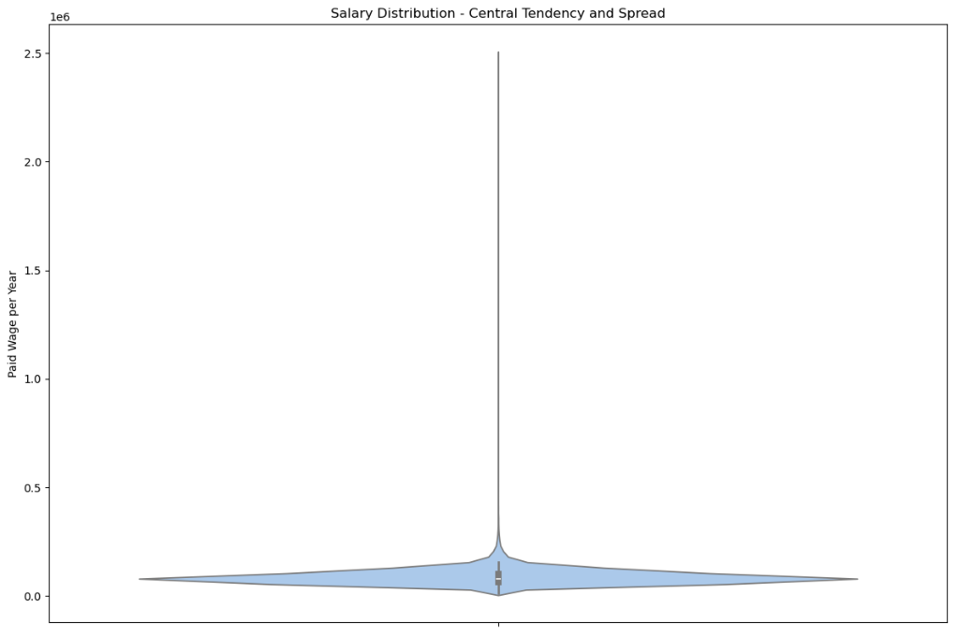
Question 6a
Question 6b

Slide 20
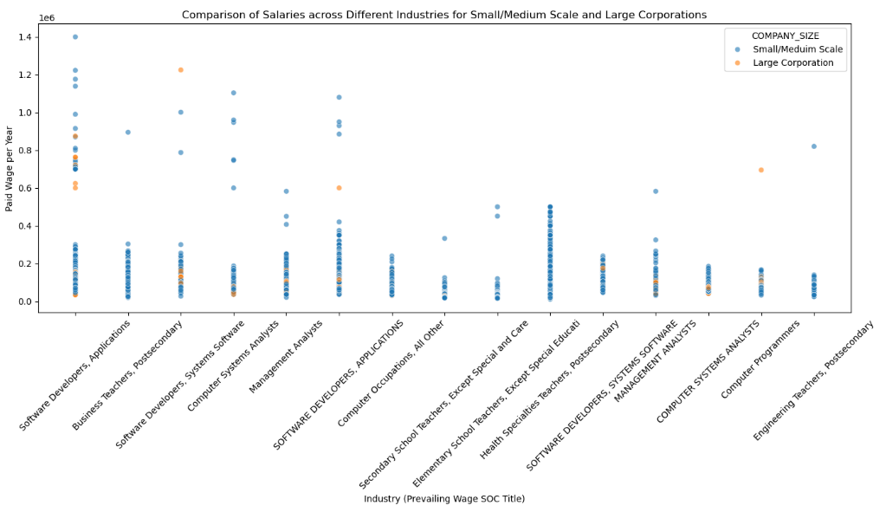
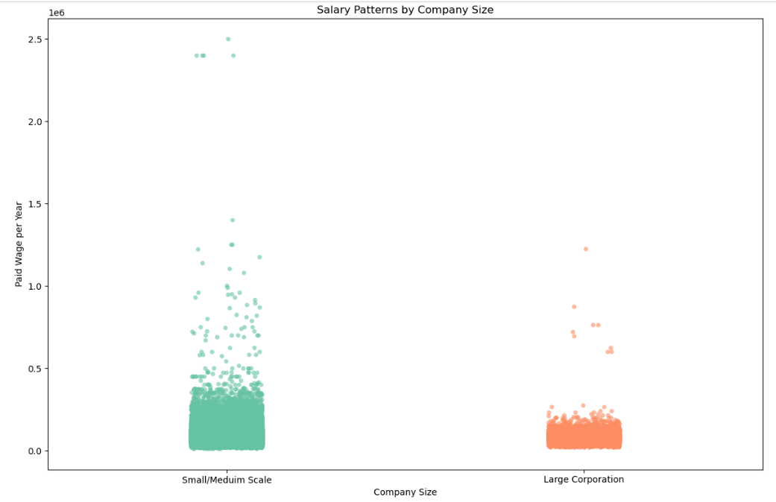
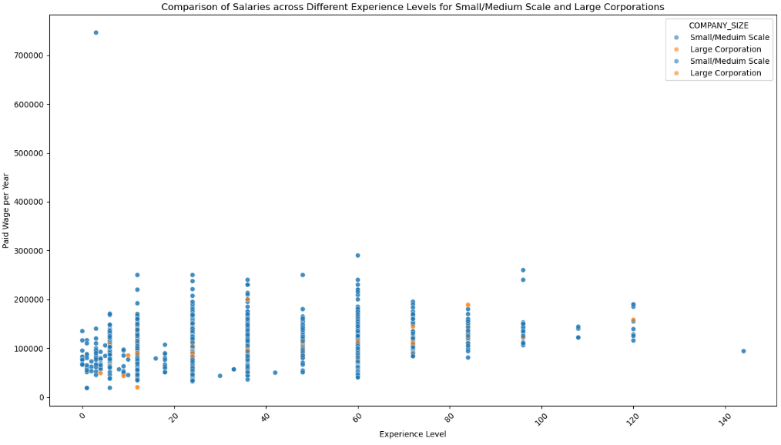
Question 6c

Slide 21
Question #7: How does company size or industry influence salary levels for data-related roles?
7a - Do larger companies or certain industries tend to offer higher salaries for similar roles?
7b - Is there a significant salary difference within industries (e.g., Tech vs. Healthcare) for the same job title?
7c - Do small startups or large corporations offer better salary growth opportunities over time?

Slide 22
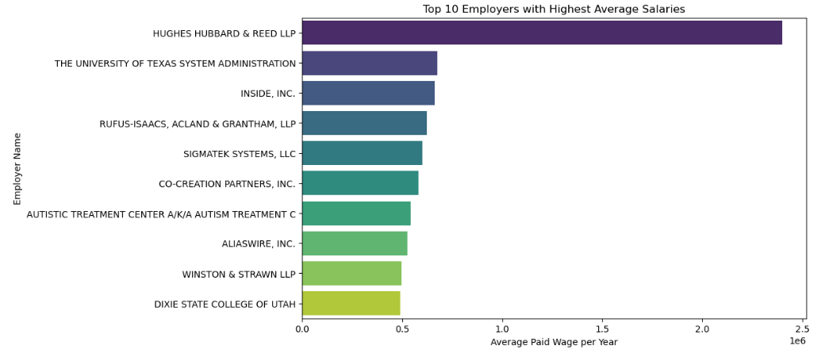
Question 7a

Slide 23
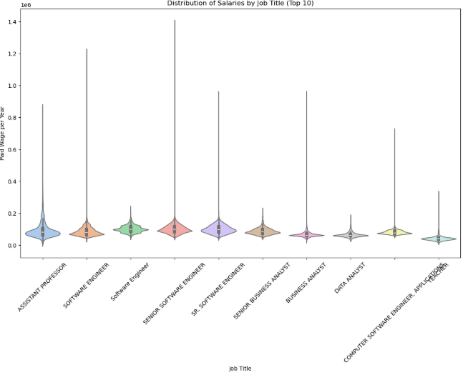
Question 7b

Slide 24
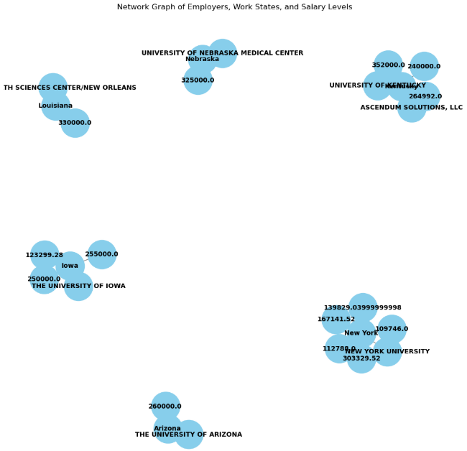
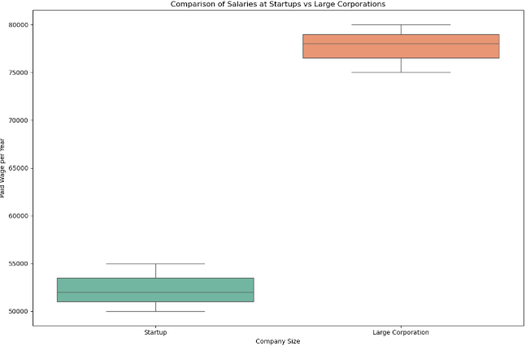
Question 7c

